Slide 1
Object oriented programming
Iván Guerrero Román

Slide 2
Session #1
Topics
Java
Variables
Conditionals
Cycles
Functions
Arrays

Slide 3
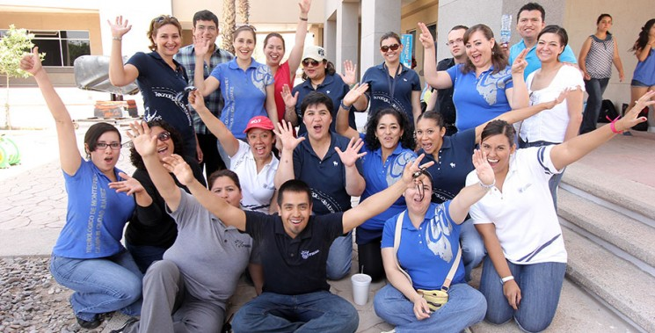
From my programming fundamentals’ course I remember…

Slide 4
Introduction to Java

Slide 5


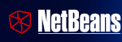
Programming environment
Code editor
Textpad
Notepad
…
Java programming language
JRE: Java Runtime Environment
SDK: Software Development Kit
IDE: Integrated Development Environment
Eclipse
NetBeans
…

Slide 6
Basic structure
import java.io.*;
public class MyClass {
public static void main(String[] args) {
System.out.println(“Hello world”);
}
}

Slide 7
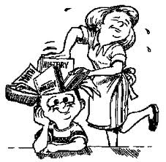



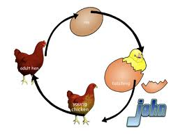
Basic programming elements
Variables: Store data
Conditionals: Make decisions
Cycles: Perform instructions multiple times

Slide 8
Variable
Definition: Memory space to store a value
Syntax
int myNumber = 8;
String myString = “Object Oriented Programming”;
Data type
Instruction ending operator
Variable name (identifier)
Stored value
Assignment operator

Slide 9
Integer data types
Data type | Bits | Minimum number | Maximum number
byte | 8 | -128 | 127
short | 16 | -32,768 | 32,767
int | 32 | -2,147,483,648 | 2,147,483,647
long | 64 | -9,223,372,036,854,775,808 | 9,223,372,036,854,775,807
Why is this important?
public class Integers {
public static void main(String[] args) {
int a;
a = (int)Math.pow(2,31);
a++;
System.out.println(a);
}
}

Slide 10
Other data types
float
32 bits
double
64 bits
boolean
true o false
char
16 bits
Stores a character (symbol)

Slide 11
Conditionals
Definition: Structure to choose between 2 possible options depending on a condition to be evaluated as true or false.
Syntax:
if ( CONDITION )
{
Instructions for the TRUE case
}
else
{
Instructions for the FALSE case
}

Slide 12
Cycles
Definition: They allow the execution of a set of instructions repeatedly.
Syntax
while ( CONDITION )
{
Instruction set
}

Slide 13
While and Do While
Syntax
while ( CONDITION ) {
Instruction set
}
do {
Instruction set
} while ( CONDITION );
The main difference between the two is that in a Do-While statement, the condition is verified by the end of the execution of the instruction set

Slide 14
For
Syntax
for (INITIALIZER; CONDITION; ITERATOR) {
Instruction set
}
Initializer: It runs once before the cycle begins. Generally used to initialize variables
Condition: Must be a Boolean expression. It is evaluated before each iteration.
Iterator: Performed by the end of the instruction set

Slide 15
Input / Output
Which ones have you used?
BufferedReader
System.console
JOptionPane
Scanner

Slide 16
Fractional digits challenge
Jaime, the lazy guinea pig we all love, has a craze for multiplying all the numbers he sees when walking down the street. We could even say he is very fast doing this task.
Jaime also loves sleeping, but he can’t do it without first doing his multiplications. One of his friends, Jiren, doesn’t like to see him asleep and decided to put a challenge on Jaime, he thought: What would happen if Jaime can’t see the numbers he has to multiply?
After a while, Jiren gave Jaime a fraction a/b and asked the following: What is the value of the multiplication of the first n digits of the decimal expression after the decimal point?
Jaime hurried to answer that in many cases the result will be 0, then his friend, in order to make it more interesting, told him that all the zeros were to be changed by ones before multiplying. For example, 3/96=0.03125, but changing the 0’s to 1’s would be 0.13125, and if the multiplication of the first 3 digits after the decimal point were asked, the answer would be 3. Can you help Jaime solve the challenge of his friend (Jaime is very sleepy right now and if you help him he could sleep a lot)?

Slide 17
Input
The first line of the input contains one integer T(1<=T<=100), the number of test cases. The next T lines contain 3 integers each a, b, n (1<=a<b<=10⁴, 1<=n<=10¹⁸).
Output
For each case output in a line the value of the multiplication of the first n digits after the decimal point of the fraction a/b. As the answer can be very large, print it modulus 188888881.
Example:
Input
2
3 96 12
1 3 3
Output:
30
27
Extracted from ICPC
- Gran premio de México 2018
- Repechaje

Slide 18
Session #1
Topics
Java
Variables
Conditionals
Cycles
Functions
Arrays

